Slide 1

TailCutter: Wisely Cutting Tail Latency in Cloud CDN under Cost Constraints
Zeqi Lai¹, Yong Cui¹, Minming Li², Zhenhua Li³, Ningwei Dai¹, and Yuchi Chen¹
¹Department of Computer Science and Technology, Tsinghua University, China
²Department of Computer Science, City University of Hong Kong, China
³School of Software, TNLIST, and KLISS MoE, Tsinghua University, China

Slide 2
Outline
Background & Motivating Measurement
TailCutter Design
Implementation & Evaluation
Conclusion

Slide 3
Outline
Background & Motivating Measurement
TailCutter Design
Implementation & Evaluation
Conclusion

Slide 4
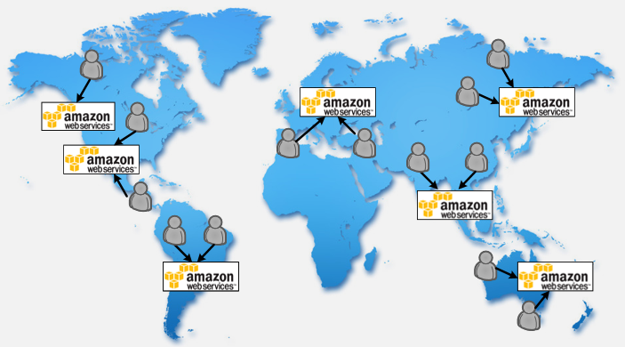
Background
Cloud storage becomes a popular solution for online data storage
Cloud CDN: new breed of CDN based on storage clouds
Many applications are built on cloud CDN
Benefits: lower cost, lower latency (using the nearest data center)

Slide 5
Background
High Tail Latency problem
  Fetching content from a single serving node is associated with high latency variance
  This phenomena exists in many modern dedicated data centers [SIGCOMM2011] [SIGCOMM2012]
  Question: Does the High Tail Latency problem happen in cloud CDN scenarios?

Slide 6
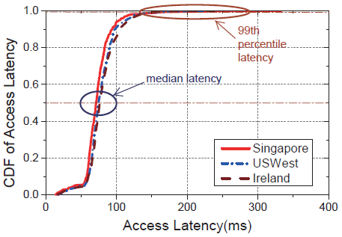
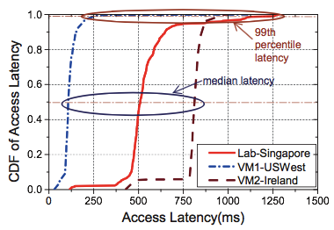
Problem: high latency variation in cloud CDN
Measurement study: identifying the tail latency
  Latency distribution inside data centers: from Amazon EC2 to S3
  Latency distribution over the Internet: from users to S3
  Issue a single GET request to download a 100KB file in every 10s a day
Latency inside DCs
Latency over the Internet

Slide 7
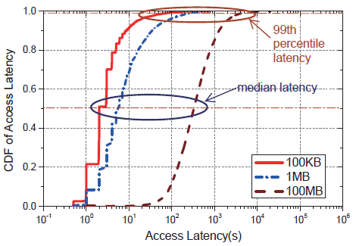
Problem: high latency variation in cloud CDN
Measurement study: identifying the tail latency
  Large scale latency analysis on 2TB data trace collected from 783,944 QQ Xuanfeng (a commercial cloud CDN provider) users
  Finding: 99th percentile latency can be up to 49x of the median!
Latency distribution of 783,944 Xuanfeng users

Slide 8
Why does high latency variance exist?
These variances are caused by many factors
  Shared resources competition
  Equipment failure, etc.[1]
Factors are so complicated and inevitable
  A feasible solution
  Need to reduce the serving latency while living with the high variability
[1] J. Dean and L. A. Barroso, “The tail at scale,” Communications of the ACM, 2013.

Slide 9
Impact of high latency variance
Performance of delay-sensitive apps
  For popular apps, even 1% of traffic corresponds to a significant volume of users
  For apps where the user is required to download several objects, the user-perceived latency is constrained by the last downloaded object
Web Page Load

Slide 10
How to decrease high latency variance?
A straightforward method
  Sending multiple requests to different cloud data centers, and use the first one returned

Slide 11
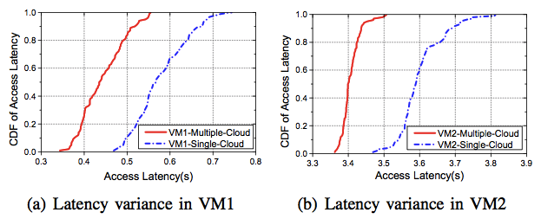
Effectiveness of leveraging multiple clouds
Experiment on multiple clouds
  Setup: 2 VMs, 2 Amazon S3 data centers (1 MB replica)
  Results: leveraging multiple cloud data centers can effectively reduce the latency variance and decrease the user-perceived latency
  But it costs double traffic (money)!

Slide 12
Key challenges
How to reduce the complicated and inevitable high latency variation in cloud CDN?
How to control the cloud traffic cost not to exceed the budget of app provider?
How to find a low complexity and high efficiency solution considering of a large amount of files and users in cloud CDN?

Slide 13
Outline
Background & Motivating Measurement
TailCutter Design
Implementation & Evaluation
Conclusion

Slide 14
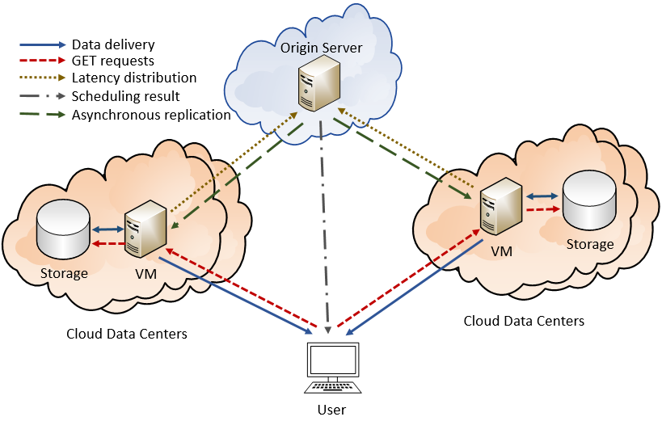
TailCutter: reducing tail latency in cloud CDN
TailCutter Overview
  Basic idea: a client sends a set of
  requests to multiple clouds to get
  different data to reduce tail latency
  under cost constraints
  Origin server: store the original
  data and run the scheduling
  algorithm to optimize tail latency
  under the cost constraints
  VM in cloud data center: measure
  the latency distribution
  User: issue a set of GET requests to multiple cloud data centers

Slide 15
TailCutter: reducing tail latency in cloud CDN
Formulating Tail Latency Minimization problem
  Scenario: users from different areas send file requests to different clouds to fetch data
  Goal: Minimize the maximum user perceived latency
  Constraints:
    Every user needs to get enough data
    App provider has a total cost budget
    Bandwidth constraint between user and cloud
    Bandwidth constraint of cloud

Slide 16
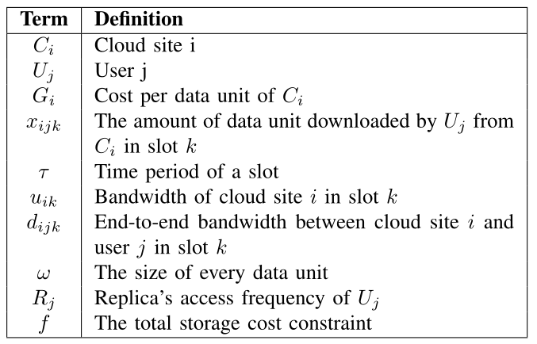

TailCutter: reducing tail latency in cloud CDN
Summary of notations
  M cloud sites, N users
  Time is slotted, each one
  lasts for $τ$ seconds, K slots totally
  Each replica is split into multiple
  data units, and a request fetches
  a certain number of data units

Slide 17
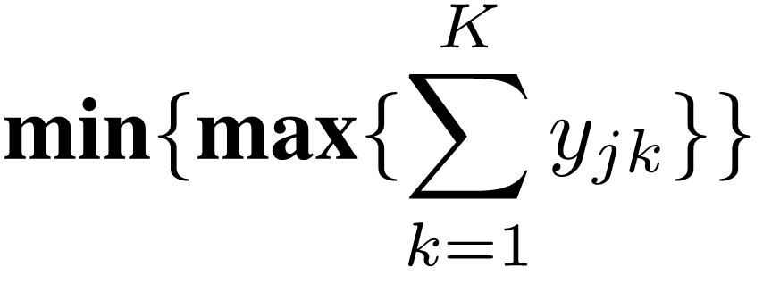
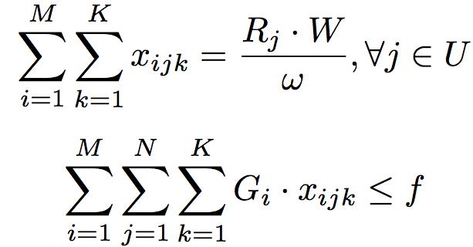
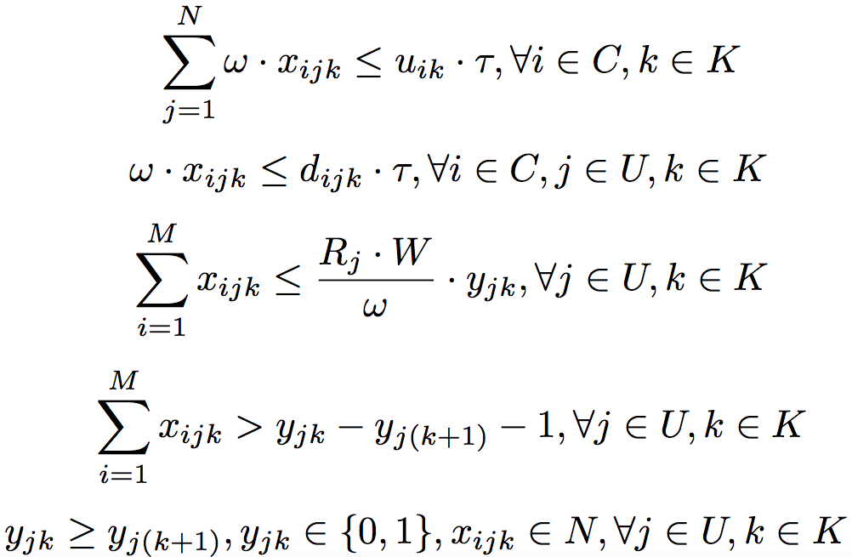
Cutting tail latency under Cost Constraints
Reducing the maximum user perceived latency in cloud CDN under the cost constraints
0-1 variable，whether user j in slot k is still active
Constraint 3: total bandwidth constraint of cloud
Constraint 1: every user must get enough data
Constraint 4: end-to-end bandwidth constraint
Constraint 5: integer constraint of variables, y is nonincreasing
Constraint 2: total cost can’t exceed the given budget

Slide 18

Scenario I: 2 clouds in a single time slot
Two clouds in a single time slot: Feasibility checking
  the cost of cloud satisfies G1 ≤ G2
C1
C2

Slide 19
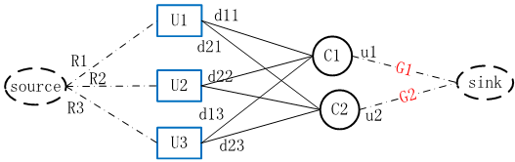
Scenario II: Multiple clouds in a single time slot
Maximum Tail Minimization Algorithm (MTMA)
  1) construct a flow network graph G, and transform TLM to the MCMF problem;
  2) use binary search to find a latency D, so that MCMF has a solution while the corresponding cost is under constraint f.
Single slot

Slide 20
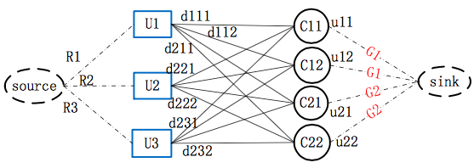
Scenario III: multiple clouds in multiple time slots
MTMA in multiple time slots scenarios
  Assume the number of time slots is D
  Making copies of cloud data centers for different time slots in D
Cloud 1 in time slot 1
Single slots
Multiple slots

Slide 21
Outline
Background & Motivating Measurement
TailCutter Design
Implementation & Evaluation
Conclusion

Slide 22
Performance evaluation
Implementation & Experiment setup
  Implement TailCutter prototype over Amazon and Windows Azure including 12 clients and 20 clouds
  Select workload from 12 subnetworks randomly
    Light workload: ≤512KB data size
    Heavy workload: >512KB data size
  Prototype: using real-world light & heavy workloads to evaluate the performance in different scales
  Trace-driven simulation: using 821 million flow trace collected from a major ISP in China

Slide 23
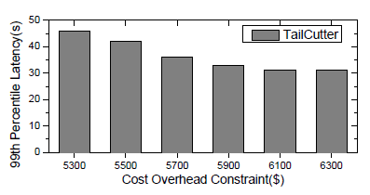
Performance evaluation
Cost-efficiency evaluation in satisfying cost constraint
  At the higher end of the examined range of budget f, TailCutter significantly reduces the tail latency up to 30%

Slide 24
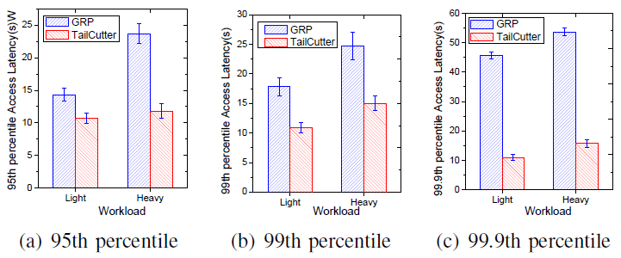
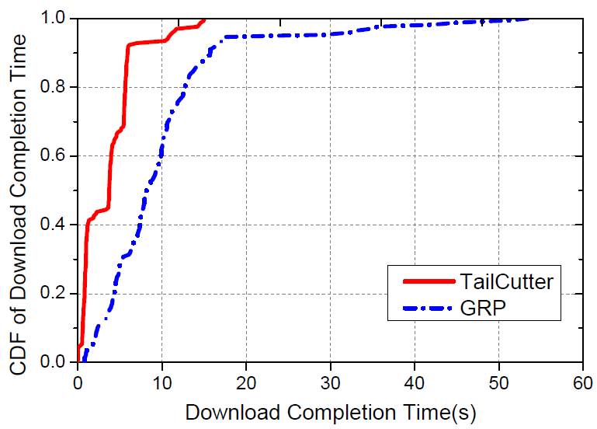
Performance evaluation
Performance (TailCutter vs GRP [INFOCOM2012])
  Prototype results: effectively reduce the latency variance compared with GRP (up to 48% tail latency reduction)
48%
Ability to reduce serving latency
Prototype results

Slide 25
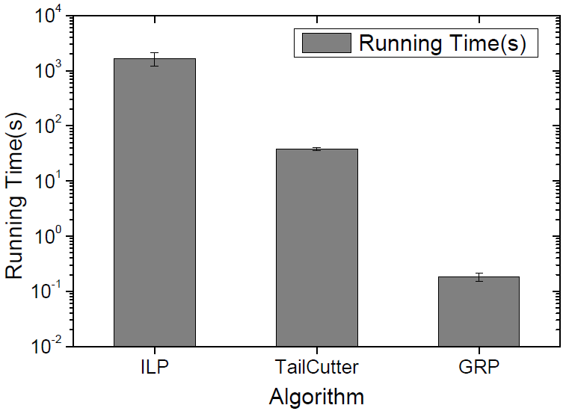
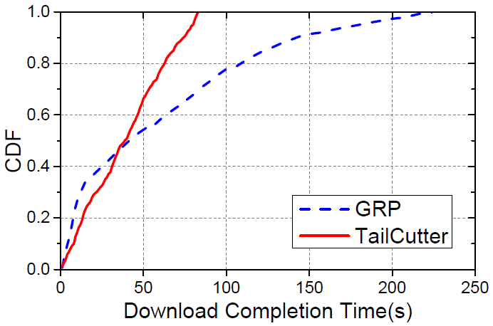
Performance evaluation
Performance (TailCutter vs GRP [INFOCOM2012])
  Running time: consuming 100s to obtain the scheduling results for the next 1 hour is feasible for a real world workload monitor system
  Large scale simulation: achieving up to 68% tail latency reduction
Running time in practice
Simulation results

Slide 26
Outline
Background & Motivating Measurement
TailCutter Design
Implementation & Evaluation
Conclusion

Slide 27
Conclusion
Finding Tail Latency
  Measure and analyze the latency performance of cloud CDN
  The high tail latency problem indeed exists in cloud CDN
Formulating TLM problem
  Minimize the tail latency in the network with high latency variance
Proposing TailCutter
  The request scheduling mechanism that leverages multiple requests to different cloud data centers to reduce tail latency
  Cut up to 68% tail latency in cloud CDN

Slide 28
Thank you!
Questions?

